Slide 1
INFORMED SEARCH ALGORITHMS

Slide 2
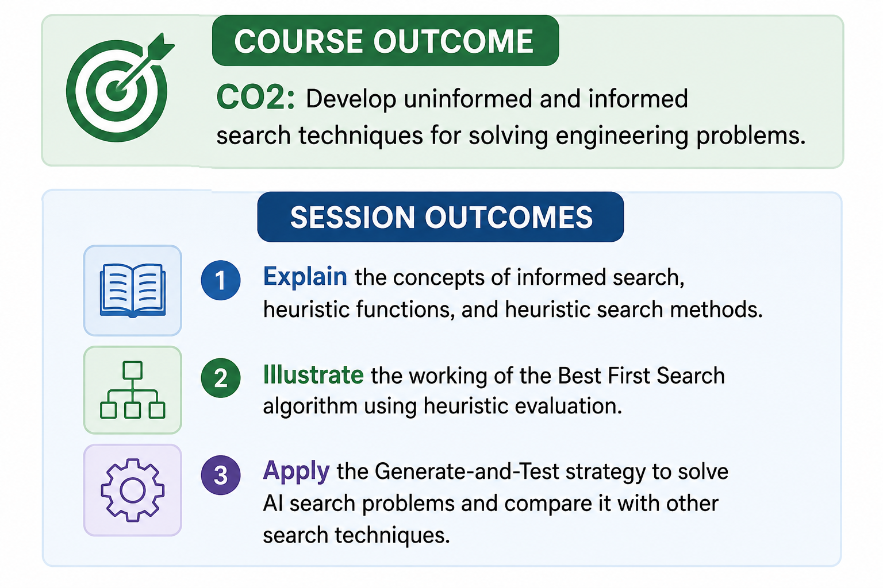

Slide 3
SEARCH ALGORITHMS
Uninformed search algorithms – look through search space for all possible solutions of the problem without having any additional knowledge about search space.
Informed search algorithm contains an array of knowledge such as how far we are from the goal, path cost, how to reach to goal node, etc. This knowledge help agents to explore less to the search space and find more efficiently the goal node.
Informed search algorithms use heuristic functions that are specific to the problem, apply them to guide the search through the search space to reduce the amount of time spent in searching –also called as Heuristic search.
more useful for large search space.

Slide 4
HEURISTICS FUNCTION
Heuristic is a function which is used in Informed Search, and it finds the most promising path.
It takes the current state of the agent as its input and produces the estimation of how close agent is from the goal.
The heuristic method, however, might not always give the best solution, but it guaranteed to find a good solution in reasonable time.
Heuristic function is represented by h(n), and it calculates the cost of an optimal path between the pair of states.
The value of the heuristic function is always positive.
Heuristic algorithms are more efficient because they take advantage of feedback from the data to direct the search path.
Admissibility of the heuristic function is given as: h(n) <= h*(n) Here h(n) is heuristic cost, and h*(n) is the estimated cost. Hence heuristic cost should be less than or equal to the estimated cost.

Slide 5
HEURISTIC SEARCH METHODS
Heuristic search methods use knowledge about the problem domain and choose promising operators first.
Steps to find a solution by using the heuristic technique:
1. Add domain-specific information to select what is the best path to continue searching along.
2. Define a heuristic function h(n) that estimates the ‘goodness’ of a node n.
Specifically, h(n) = estimated cost(or distance) of minimal cost path from n to a goal state.
The term, heuristic means ‘serving to aid discovery’ and is an estimate, based on domain specific information that is computable from the current state description of how close we are to a goal.

Slide 6
Add domain-specific information :
Ex: Finding a route from one city to another city is an example of a search problem in which different search orders and the use of heuristic knowledge are easily understood.
1. State: The current city in which the traveler is located.
2. Operators: Roads linking the current city to other cities.
3. Cost Metric: The cost of taking a given road between cities.
4. Heuristic information: The search could be guided by the direction of the goal city from the current city, or we could use airline distance as an estimate of the distance to the goal.

Slide 7
BEST FIRST SEARCH
In BFS and DFS, when we are at a node, we can consider any of the adjacent as next node. So both BFS and DFS blindly explore paths without considering any cost function.
The idea of Best First Search is to use an evaluation function to decide which adjacent is most promising and then explore.
We use a priority queue to store costs of nodes.
So the implementation is a variation of BFS, we just need to change Queue to Priority Queue.

Slide 8
BEST-FIRST SEARCH ALGORITHM
Greedy best-first search algorithm always selects the path which appears best at that moment.
It is the combination of depth-first search and breadth-first search algorithms.
Uses heuristic function and search.
In the best first search algorithm, we expand the node which is closest to the goal node and the closest cost is estimated by heuristic function, i.e.
f(n)= g(n) where h(n)= estimated cost from node n to the goal.
The greedy best first algorithm is implemented by the priority queue.
The Best first search uses the concept of a Priority queue and heuristic search.
To search the graph space, the BFS method uses two lists for tracking the traversal.
An ‘Open’ list which keeps track of the current ‘immediate’ nodes available for traversal and ‘CLOSED’ list that keeps track of the nodes already traversed.

Slide 9
BEST FIRST SEARCH ALGORITHM
Create 2 empty lists: OPEN and CLOSED
Start from the initial node (say N) and put it in the ‘ordered’ OPEN list
Repeat the next steps until GOAL node is reached
  If OPEN list is empty, then EXIT the loop returning ‘False’
  Select the first/top node (say N) in the OPEN list and move it to the CLOSED list. Also capture the information of the parent node
  If N is a GOAL node, then move the node to the Closed list and exit the loop returning ‘True’. The solution can be found by backtracking the path
  If N is not the GOAL node, expand node N to generate the ‘immediate’ next nodes linked to node N and add all those to the OPEN list
  Reorder the nodes in the OPEN list in ascending order according to an evaluation function f(n).

Slide 10
Advantages:
  Best first search can switch between BFS and DFS by gaining the advantages of both the algorithms.
  This algorithm is more efficient than BFS and DFS algorithms.
Disadvantages:
  It can behave as an unguided depth-first search in the worst case scenario.
  It can get stuck in a loop as DFS.
  This algorithm is not optimal.

Slide 11
EXAMPLE
S
10
A
B
C
9
8
7
D
H
8
6
F
G
6
3
E
0

Slide 12
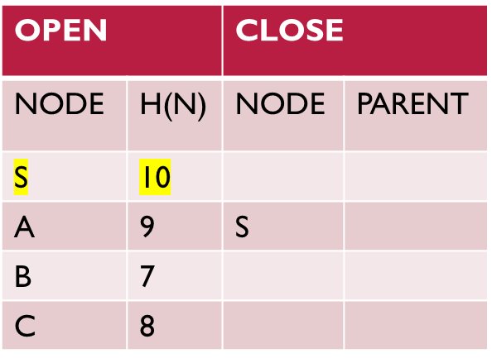
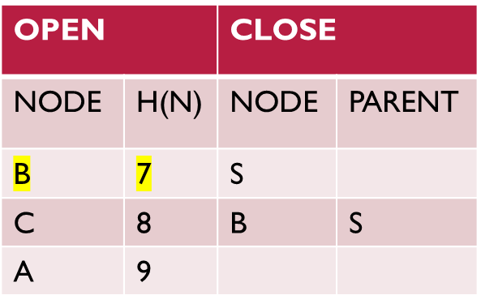
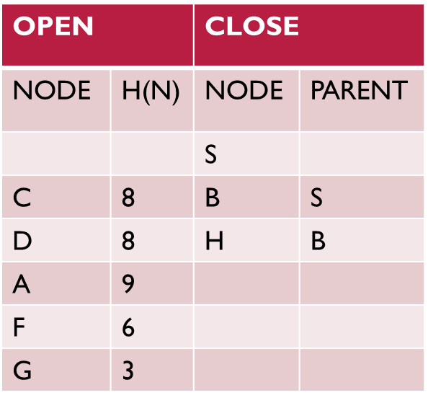
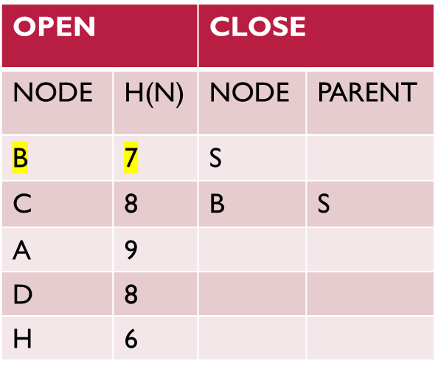
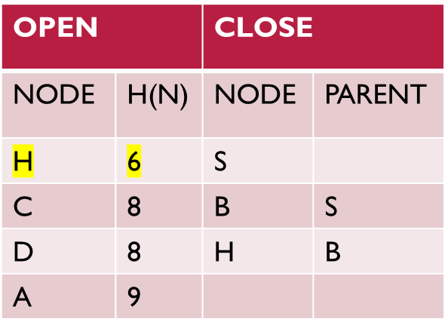
OPEN |  | CLOSE
NODE | H(N) | NODE | PARENT
S | 10

Slide 13
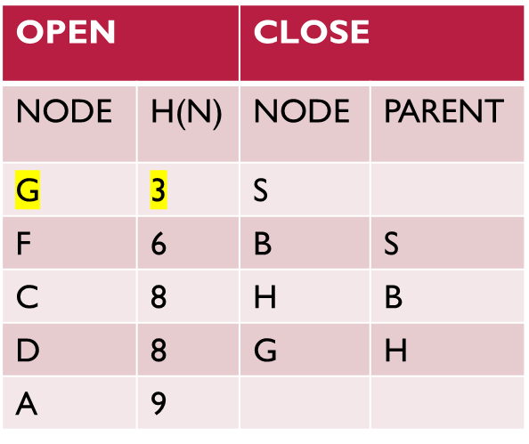
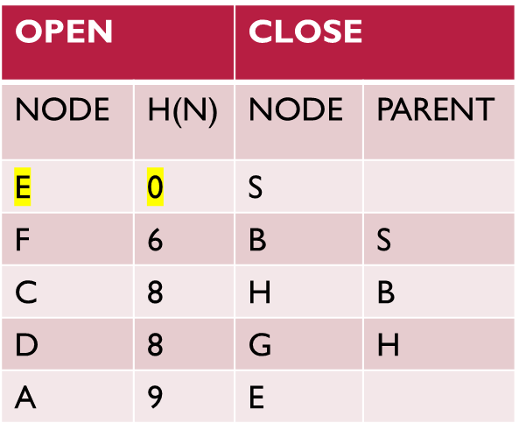
OPEN |  | CLOSE
NODE | H(N) | NODE | PARENT
F | 6 | S
C | 8 | B | S
D | 8 | H | B
A | 9 | G | H
E | 0
Path : S – B – H – G – E

Slide 14
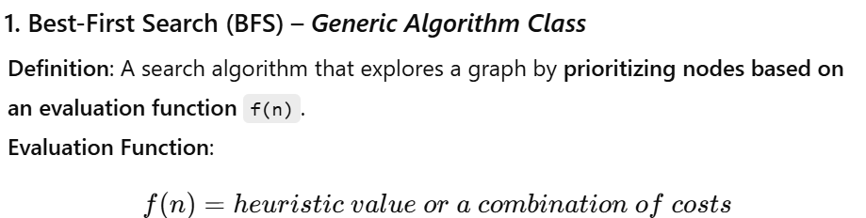
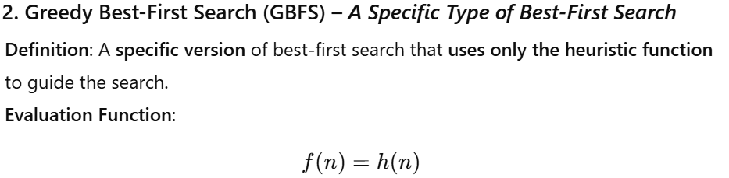
BEST FIRST SEARCH VS GBFS

Slide 15
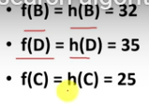
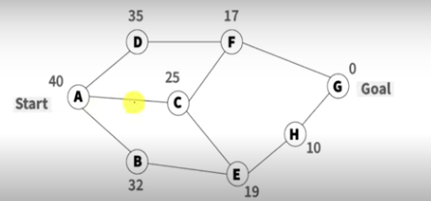



GREEDY BEST FIRST SEARCH

Slide 16
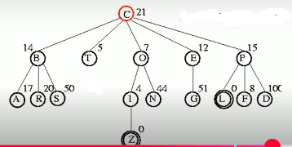
EXAMPLE
Apply the Best First Search for the following graph where C is the initial node and Z is the goal node.

Slide 17
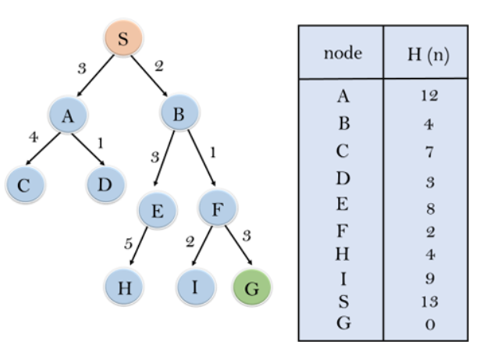
EXAMPLE:
Consider the below search problem, and we will traverse it using greedy best-first search. At each iteration, each node is expanded using evaluation function f(n)=h(n)

Slide 18
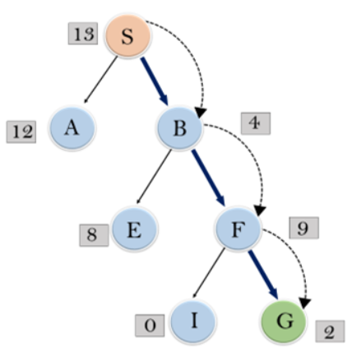
In this search example, we are using two lists which are OPEN and CLOSED Lists.
Following are the iteration for traversing the above example.
Expand the nodes of S and put in the CLOSED list
Initialization: Open [A, B], Closed [S]
Iteration 1: Open [A], Closed [S, B]
Iteration 2: Open [E, F, A], Closed [S, B]
: Open [E, A], Closed [S, B, F]
Iteration 3: Open [I, G, E, A], Closed [S, B, F]
: Open [I, E, A], Closed [S, B, F, G]
Hence the final solution path will be: S----> B----->F----> G

Slide 19
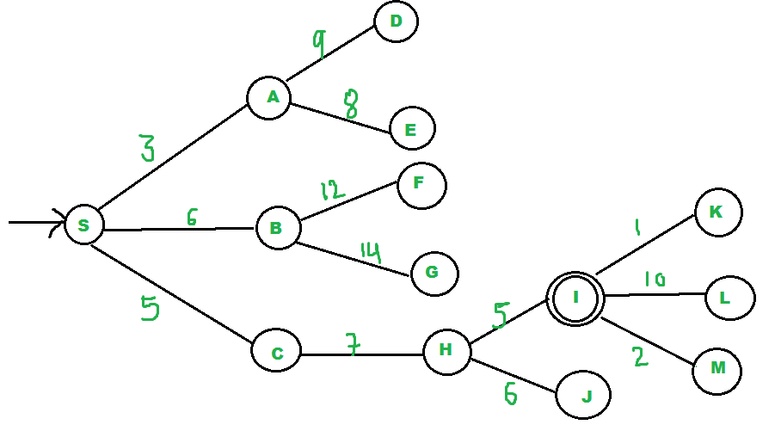
We start from source "S" and search for goal "I" using given costs.
pq initially contains S- We remove s from and process unvisited neighbors of S to pq.
pq now contains {A, C, B} (C is put before B because C has lesser cost)
We remove A from pq and process unvisited neighbors of A to pq.--pq now contains {C, B, E, D}
We remove C from pq and process unvisited neighbors of C to pq.--pq now contains {B, H, E, D}
We remove B from pq and process unvisited neighbors of B to pq.--pq now contains {H, E, D, F, G}
We remove H from pq.
Since our goal "I" is a neighbor of H, we return.

Slide 20
GENERATE AND TEST STRATEGY
Generate-and-test search algorithm is a very simple algorithm that guarantees to find a solution if done systematically and there exists a solution.
Algorithm: Generate-And-Test
1.Generate a possible solution.
2.Test to see if this is the expected solution.
3.If the solution has been found quit else go to step 1.
Generate and Test Search is a heuristic search technique based on Depth First Search with Backtracking which guarantees to find a solution if done systematically and there exists a solution.
In this technique, all the solutions are generated and tested for the best solution. It ensures that the best solution is checked against all possible generated solutions.
Generate-and-test, like depth-first search, requires that complete solutions be generated for testing.
In its most systematic form, it is only an exhaustive search of the problem space.
Solutions can also be generated randomly but solution is not guaranteed. This approach is what is known as British Museum algorithm: finding an object in the British Museum by wandering randomly.

Slide 21
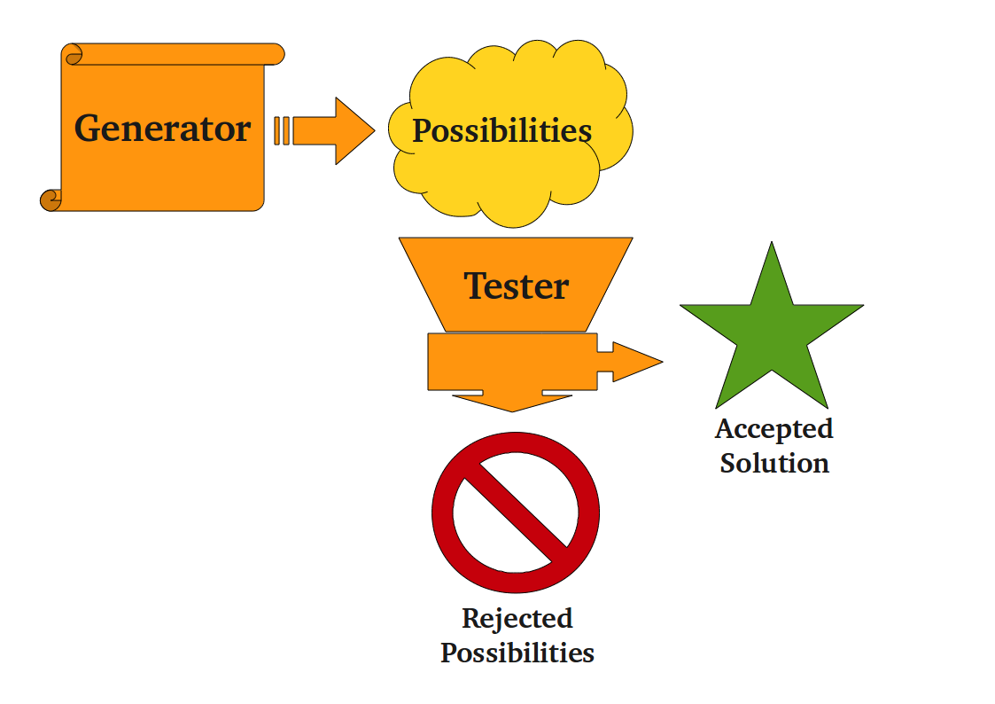
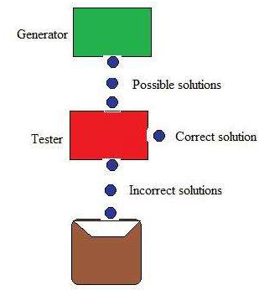
GENERATE AND TEST STRATEGY

Slide 22
APPROACHES FOLLOWED WHILE GENERATING SOLUTIONS
Generating complete solutions
Generating random solutions

Slide 23
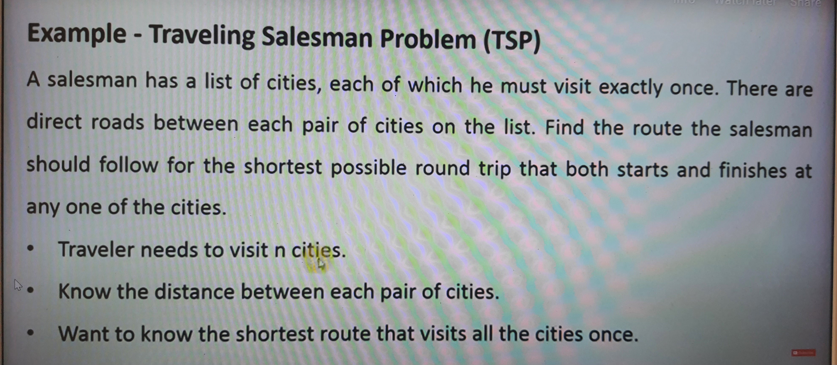
EXAMPLE - TSP

Slide 24
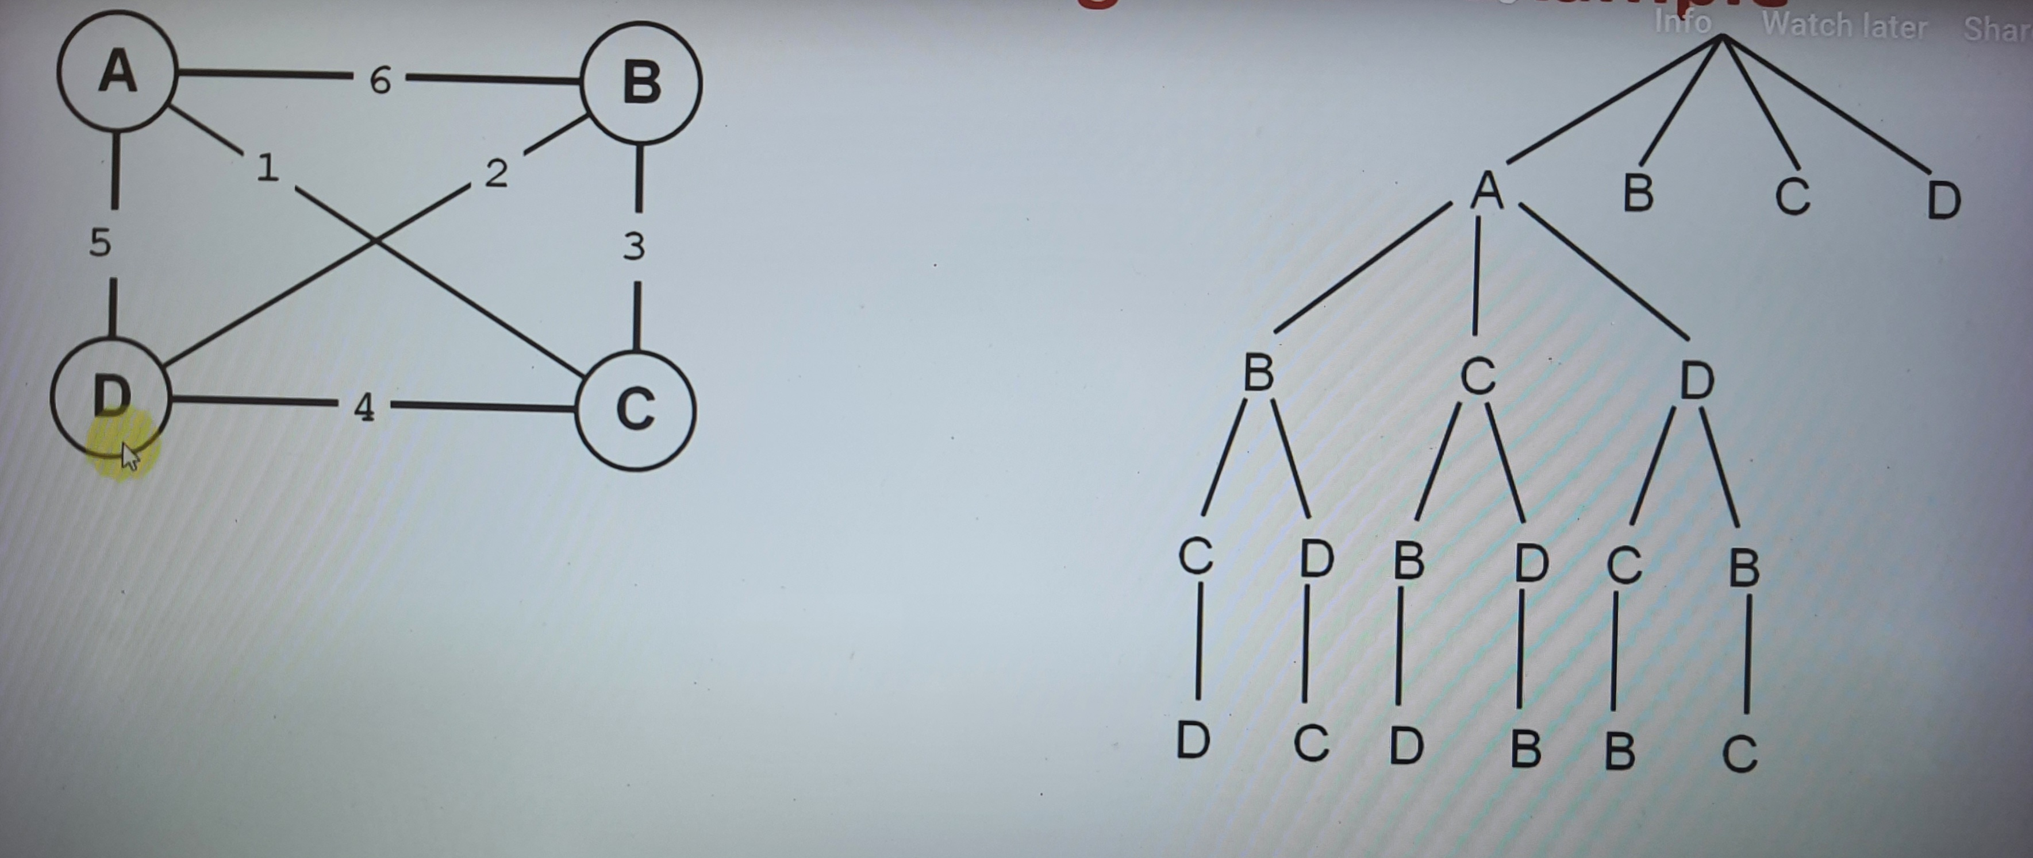

Slide 25
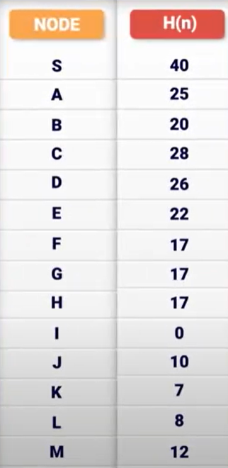
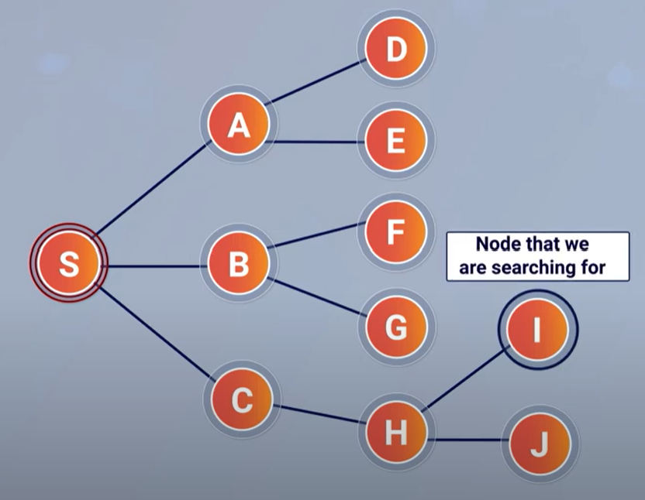

Slide 26
